Slide 1


LEARNING MANAGEMENT SYSTEM

Slide 2
LMS STANDS SORT FOR LEARNING MANAGEMENT SYSTEM
L
earning -
Because you use it to deliver education courses
M
anagement -
Because it helps you organize these courses
S
ystem -
Because an LMS is a computer program

Slide 3

DEFINITION
A learning management system (LMS) is a software application or web-based technology used to plan, implement and assess a specific learning process.
It is a set of software tools designed to manage user learning interventions including online, virtual classroom, and instructor-led courses.

Slide 4

WHAT DOES AN LMS DO EXACTLY?
An LMS handles the management and delivery of eLearning courses. An LMS lets you create eLearning content (lessons), organize it into courses, deliver the content, enroll students to said courses and finally monitor and assess their performance.

Slide 5
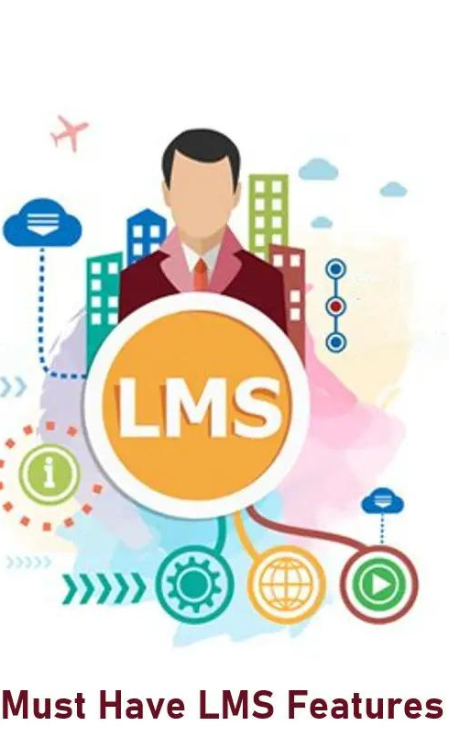
Managing users, courses, roles, and generating reports
Assessments that can handle pre/post testing
FEATURES
OF
LEARNING MANAGEMENT
SYSTEM
Making a course calendar.
Messaging and notifications.
Certification and display student's score and transcripts

Slide 6
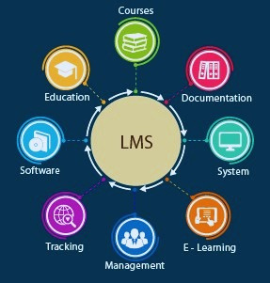
Benefits Of Learning Management Systems
Stream lined training process.
Ability to deliver engaging and motivating learning.
Centralized learning.
Simplified learning process.
Anytime, anywhere learning.
Evaluation capabilities.
Easy upgrades.
Interactive environment.

Slide 7
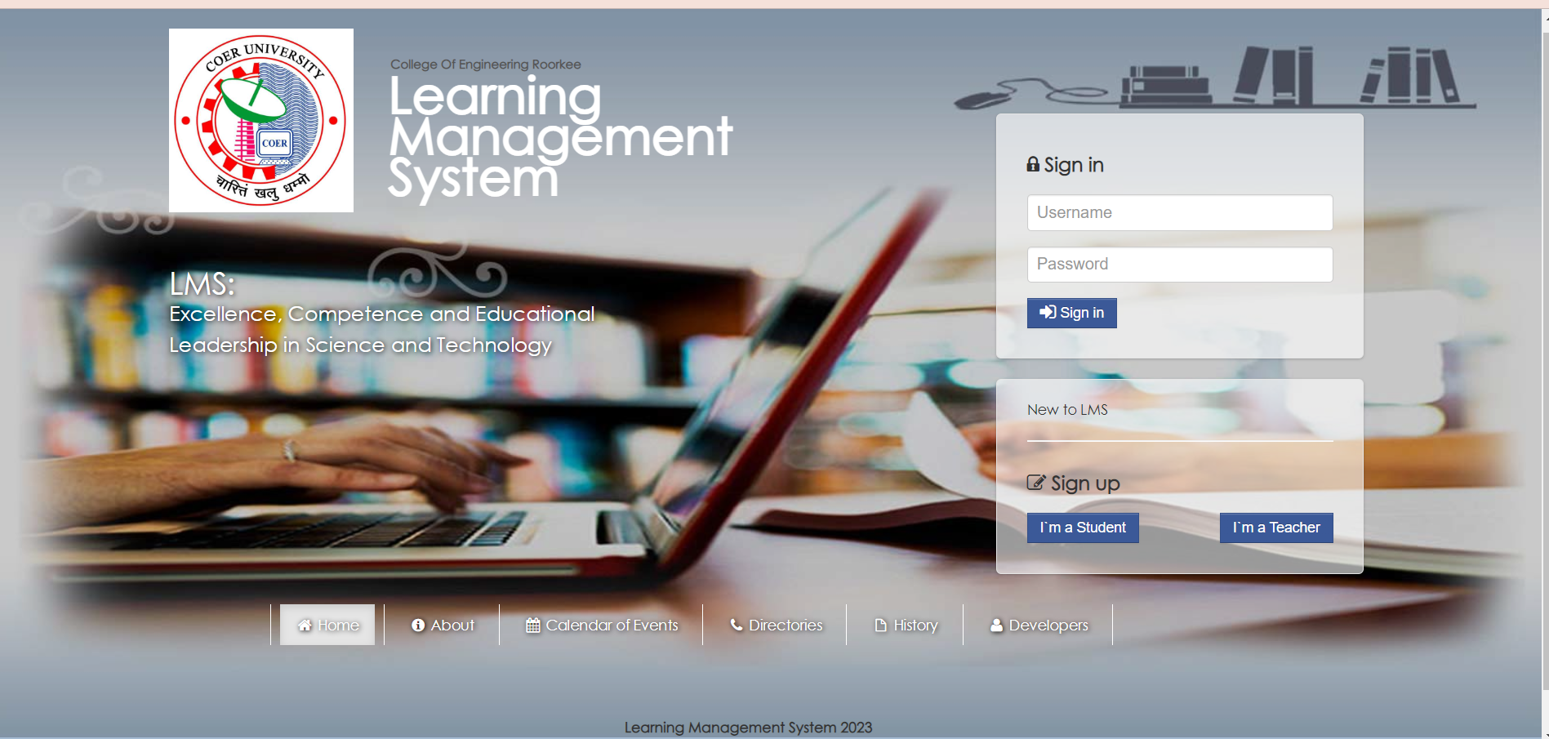
What we have done till now..

Slide 8
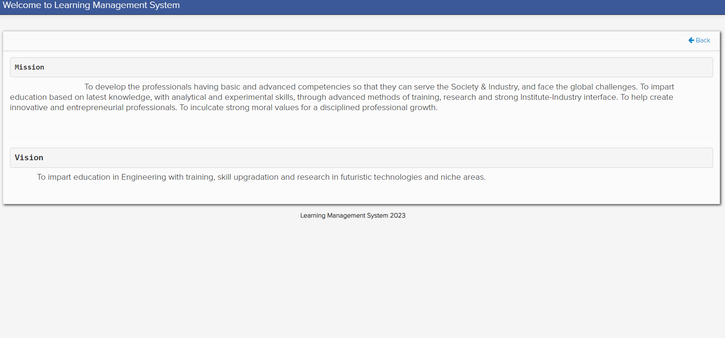

Slide 9
